Slide 1


VARDHAMAN COLLEGE OF ENGINEERING, HYDERABAD Autonomous institute affiliated to JNTUH DEPARTMENT OF CSE(AI&ML)
TITLE: Predicting Employee Retention Using Cloud
BATCH ID : 33
S. No | Roll. No | Student Name
1 | 21881A66B1 | P. Vignesh Reddy
2 | 21881A66B5 | R. Sai Siddarth
3 | 21881A66B7 | S. Chikitha Reddy
Supervisor
Dr. M.A. Jabbar
Professor & Head
Department of CSE AI & ML

Slide 2
OUTLINE
Abstract
Objective
Dataset
Technologies
Proposed Flow Diagram
Model Interface
Results and Evalution
Challenges and Limitations
Future Scope
Summary

Slide 3
Abstract
This study focuses on predicting employee retention using advanced cloud-based machine learning tools, offering a scalable and efficient solution for contemporary HR analytics. By harnessing extensive datasets that encompass critical employee information such as demographics, job satisfaction levels, performance metrics, and tenure, we developed sophisticated predictive models hosted on cloud platforms. These models are meticulously trained to detect subtle patterns and warning signs that may indicate an employee’s likelihood of leaving the organization. With an impressive accuracy of 85%, these models provide HR teams with actionable insights, enabling them to intervene proactively and implement targeted retention strategies. The cloud-based approach not only ensures seamless data processing and model deployment but also facilitates continuous model enhancement through real-time data updates and integration. This dynamic methodology empowers organizations to significantly reduce turnover rates, mitigate associated costs, and cultivate a more stable and committed workforce, ultimately driving organizational success and employee satisfaction. Furthermore, the flexibility of cloud infrastructure supports scaling the solution as the organization grows, ensuring long-term efficacy and adaptability in an ever-evolving business landscape.
Keywords: Employee turnover prediction, Random Forest, machine learning, HR analytics, retention strategies, workforce stability, predictive modeling, model accuracy.

Slide 4
Objectives
To evaluate the employee attrition factors through assessment of structured HR data.
To create a machine learning model based on Random Forest methodology targets employee retention predictions.
Training the model with essential features helps reach its best possible performance accuracy level.
To evaluate the effectiveness of the model with the performance metrics, few of the performance metrics are accuracy, precision, recall and F1- score.
The implementation of a predictive model into a cloud platform system demands both real-time functionality in addition to scalability to operate effectively in human resources management.
HR professionals need specific information through the system to stop workers from exiting before departures occur.
To verify how data-driven employee management systems perform in actual work environments to help maintain staff retention.

Slide 5
Dataset
IBM Attrition Dataset The IBM Attrition Dataset is a publicly available dataset on kaggle designed
for training and evaluating AI models for prediction.
Key features of the dataset:
Total Entries: 1,470 employees.
Columns(16 total):
Numerical Features: Monthly Income, Age, Total Working Years, Daily Rate, Hourly Rate, Monthly Rate, Distance from Home, Years at Company, Number of Companies Worked, Percent Salary Hike, Years with Current Manager.
Categorical Features: OverTime (Yes/No), Environment Satisfaction (Low, Medium, High, Very High), Job Role, Attrition (Yes/No).
Target Variable: Attrition (indicates whether an employee has left the company).

Slide 6
Technologies
AWS S3 Bucket
Amazon S3 is a scalable, high-speed, web-based cloud storage service offered by Amazon Web Services (AWS). It is designed to store and retrieve any amount of data, at any time, from anywhere on the web.
SageMaker AI
Amazon SageMaker is a fully managed service by AWS designed to make it easier for developers and data scientists to build, train, and deploy machine learning (ML) models. It abstracts the complexity of setting up ML environments and provides integrated tools for every stage of the machine learning lifecycle.
Python
Python is a high-level programming language known for its readability and ease of use. It's popular in fields like web development, data analysis, machine learning, scientific computing, and more.
Jupiter Notebook
Jupyter Notebooks are open-source web applications that allow you to create and share documents that contain live code, equations, visualizations, and narrative text. It's widely used in data science and machine learning.

Slide 7
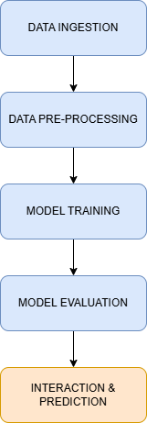
Proposed Flow Diagram
Connects to AWS S3 using boto3
Loads the IBM Attrition dataset into a Pandas DataFrame
Drops unnecessary columns (e.g., EmployeeNumber)
Covert categorical Variables into numerical values
Split data into training and testing sets
Applies standardization with standardScaler
Trains a RandomForestClassifier
Predicts test data
Computes performance metrics using sklearn.metrics

Slide 8
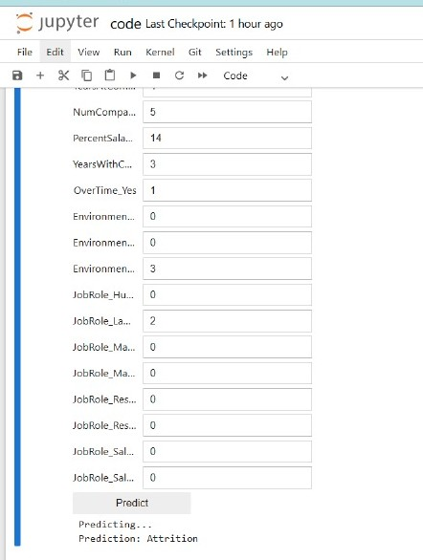
Model Interface
An IPython widget interface operated inside the Jupyter Notebook environment.
Users can access this interface to input variables describing employee attributes consisting of age, job role, income and overtime status.
The trained model uses this information to make an immediate determination about employee retention.

Slide 9
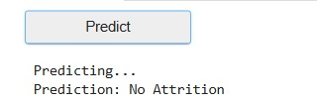
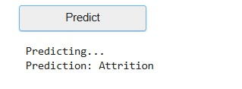
Results and Evalution
Results :
primary outcome of this project is the development of a system capable of accurately predicting employee attrition based on historical HR data. At the heart of this system lies a Random Forest Classifier trained on a curated selection of 15 important features from the IBM HR dataset. Once trained, the model was integrated into an interface where users can input employee attributes and, with a single click on the “Predict” button, receive a straightforward output: “Attrition” or “No Attrition.”
Result : Retention
Result : Attrition

Slide 10
Results and Evalution
Evaluation :
Multiple standard metrics for model assessment were calculated through the test data to evaluate model effectiveness.
Accuracy Score: Measures the overall prediction correctness.
Confusion Matrix: It will provide the detailed insight into true positives, true negatives, false negatives and false positives.
Precision, Recall, and F1-Score: These metrics will offer the deep understanding of model performance.
Metric | Result
Accuracy | 86.7%
Precession | 50.0%
Recall | 12.8%
F1-Score | 20.0%
Confusion Matrix | TP:5, FP:5, TN: 250, FN:34

Slide 11
Challenges and Limitations
Data Limitation
Cloud Infrastructure and Security
Class Imbalance
Model Generalization
Feature Interpretability
Interface and Usability Constraints

Slide 12
Future scope
Despite our project fulfilling the primary goal of predicting employee turnover through a Random Forest Classifier on AWS Cloud, there is much room for further development and improvement.
What we observed is that with a greater and more extensive dataset, the model could potentially be even more precise and practical for various companies or industries.Our dataset worked well for testing and training, but real-time company data would give the results more nuance.
Making this an in-real-time prediction system is another aspect that could be improved. While we work with static data at the moment, companies could be able to respond more quickly to attrition signals if this were combined with live HR systems.
On the side of the user, an easy and uncluttered interface or dashboard would make it easier for HR teams with no technical background to use the system.It would be very helpful to have something interactive and visual.

Slide 13
Summary
The application of Random Forest algorithm from machine learning successfully predicts employee attrition based on the IBM HR Analytics dataset during this research. The solution uses effective data cleaning combined with model training and evaluation tests and minimal cloud framework implementation to develop predictive capabilities that also provide interpretability. The data classification analysis achieved high accuracy in worker retention and established that pay levels and worktime duration along with occupation duration determine employee departures.

Slide 14


